Slide 1


Introduction to Modeling
Unified Modeling Language
SE 2217
FALL
2025 - 2026
Res. Asst. Aybüke KEÇECİ KANMAZ
Yaşar University

Slide 2
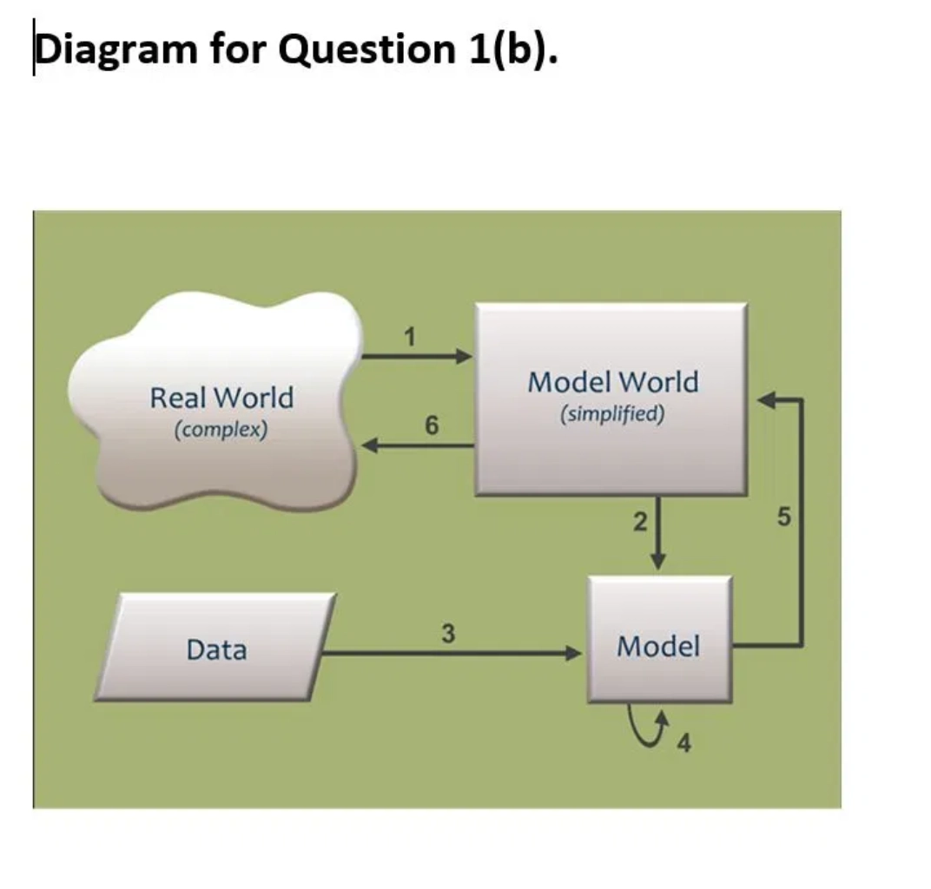
Introduction to Modeling
Models are simplified representations of real-world systems
Models abstract away irrelevant details
Models reduce scale and complexity
Models focus on specific aspects of a system (e.g., cost, durability)
Models help understand, evaluate, and critique systems more efficiently
Modeling has been essential in engineering, art, and construction for centuries

Slide 3







Benefits of Modeling in Software Engineering
Visualization
Better Planning
Complex software designs become easier to understand through visual representation
Improves project planning and resource allocation
Clear Communication
Risk Prediction
Facilitates communication between stakeholders, developers, and operations personnel
Helps identify potential issues before implementation
Cost Reduction
Complexity Management
Saves time, effort, and money by detecting problems early
Breaks down complex systems into manageable components
"Modeling is a key driver for saving time, effort, and money in software development."

Slide 4
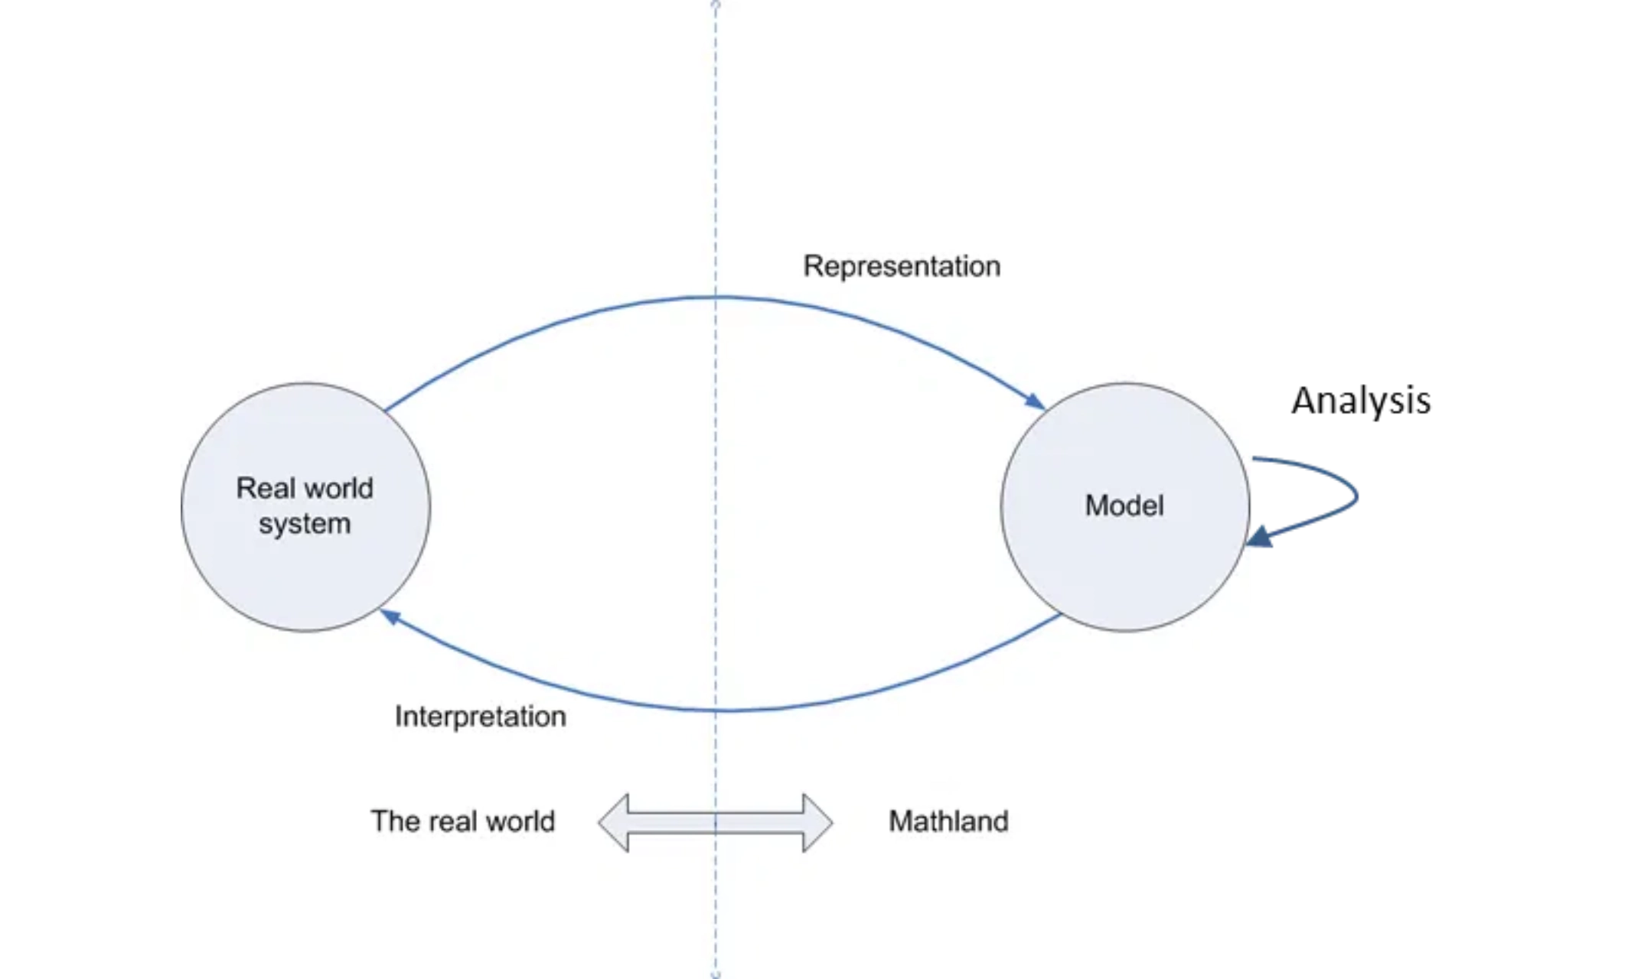
UML in Software Development Lifecycle
1. OO-Analysis (OOA)
Gather and analyze user requirements
What is the system to do?
What services will it provide?
Provide requirements for designer
2. OO-Design (OOD)
Define system structure and component interactions
What will be the parts & structure?
How will they interact?
Provide blueprint for programmer
3. OO-Programming (OOP)
Complete Software Lifecycle with UML:
Convert design into code and test the system
Gather Requirements → Model with UML
→ Code Methods → Test and Finalize
Convert skeleton code into real code
Test the system
Finalize the OO software product
UML diagrams help translate requirements into design and implementation throughout the entire software development process

Slide 5

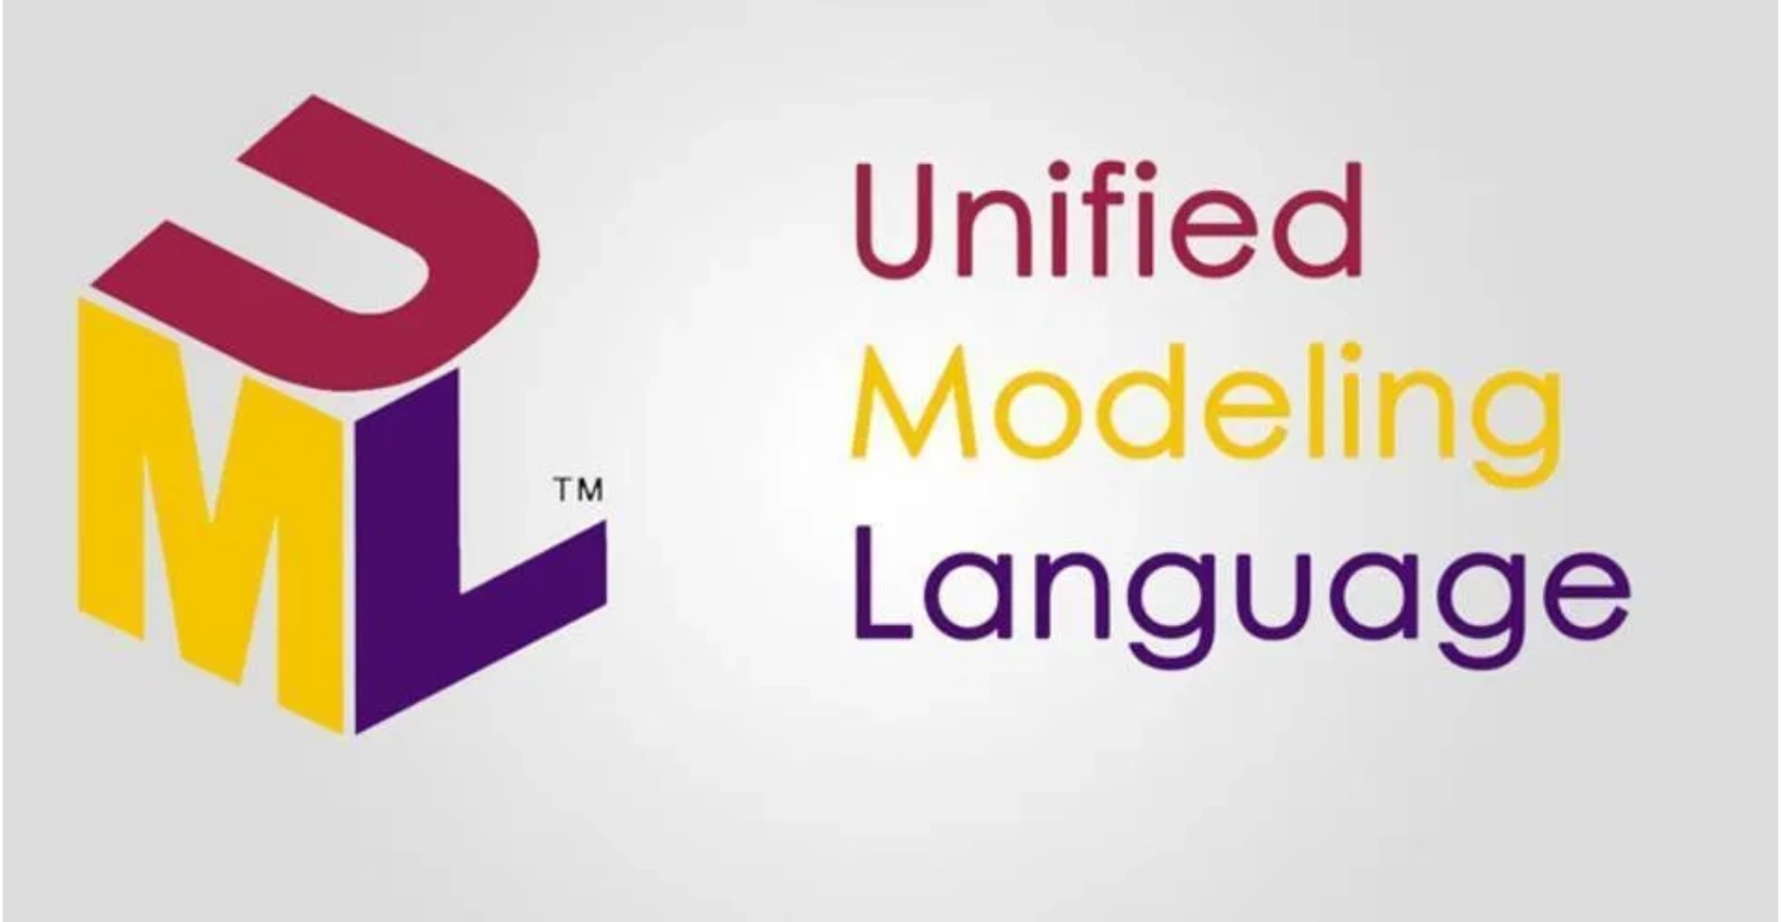
What is UML?
Unified Modeling Language (UML) is a standardized visual modeling language for software engineering
Purpose:
Applications:
Provides a standard way to visualize system design
Software architecture documentation
Creates visual models of software systems
Requirements specification
System behavior modeling
Serves as the de-facto standard for object-oriented software diagramming
Object-oriented design representation

Slide 6
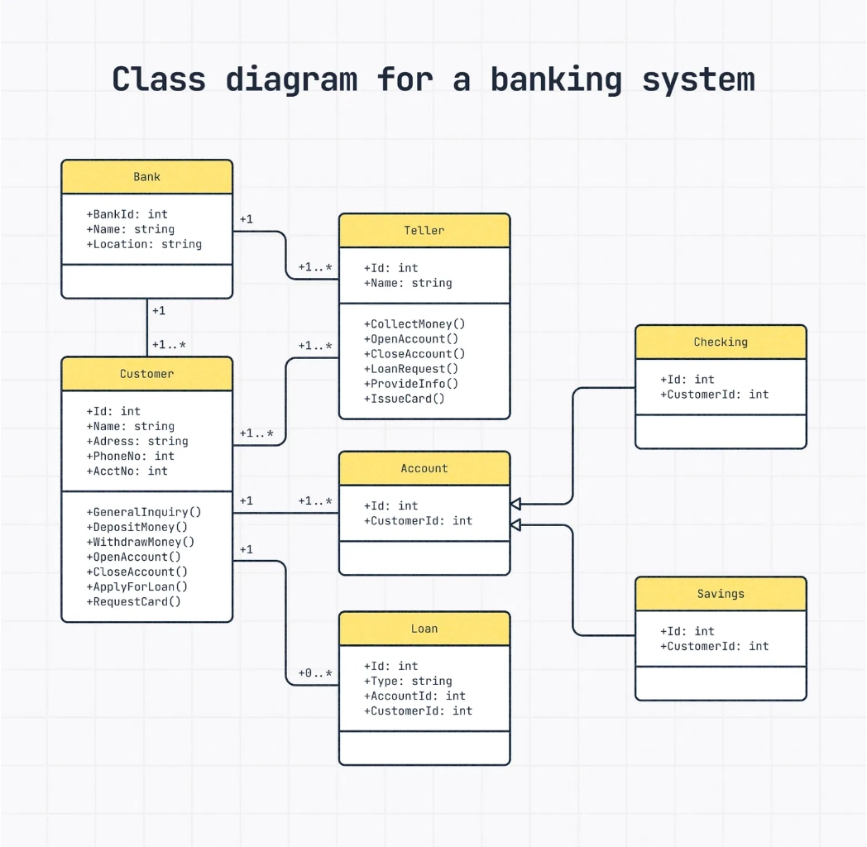
UML Diagram Classification
Structure Diagrams
Emphasize the things that must be present in the system being modeled
Behavior Diagrams
Emphasize what must happen in the system being modeled
Used extensively to describe software functionality
Interaction Diagrams
Emphasize the flow of control and data among system elements
A subset of behavior diagrams focusing on object interactions

Slide 7

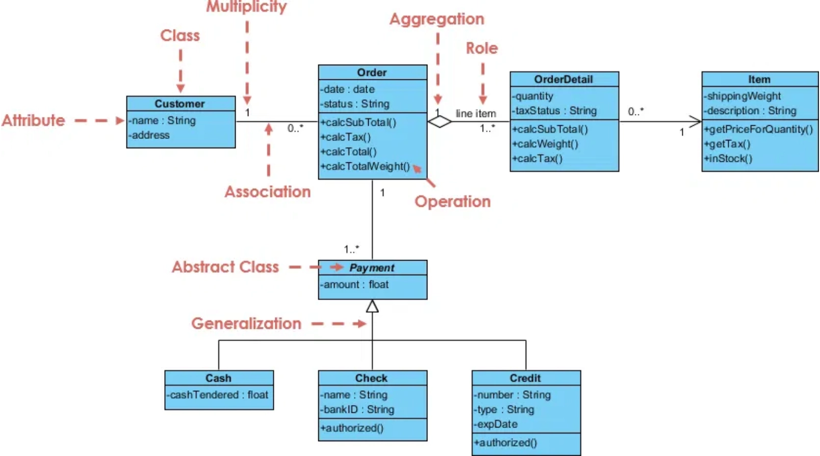
UML Diagram Types in Detail
Structure Diagrams
Behavior Diagrams
Class Diagram
Use Case Diagram
Shows classes, attributes, operations, and relationships between classes. The most commonly used UML diagram.
Shows functionality from user perspective, illustrating interactions between users and the system.
Component Diagram
Activity Diagram
Shows components and their dependencies, focusing on the physical structure of the implementation.
Shows workflow of stepwise activities and actions with support for choice, iteration, and concurrency.
Deployment Diagram
Sequence Diagram – Interaction Diagram
Shows the physical deployment of artifacts on nodes (hardware/software execution environments).
Shows object interactions arranged in time sequence, emphasizing the exchange of messages between objects.

Slide 8

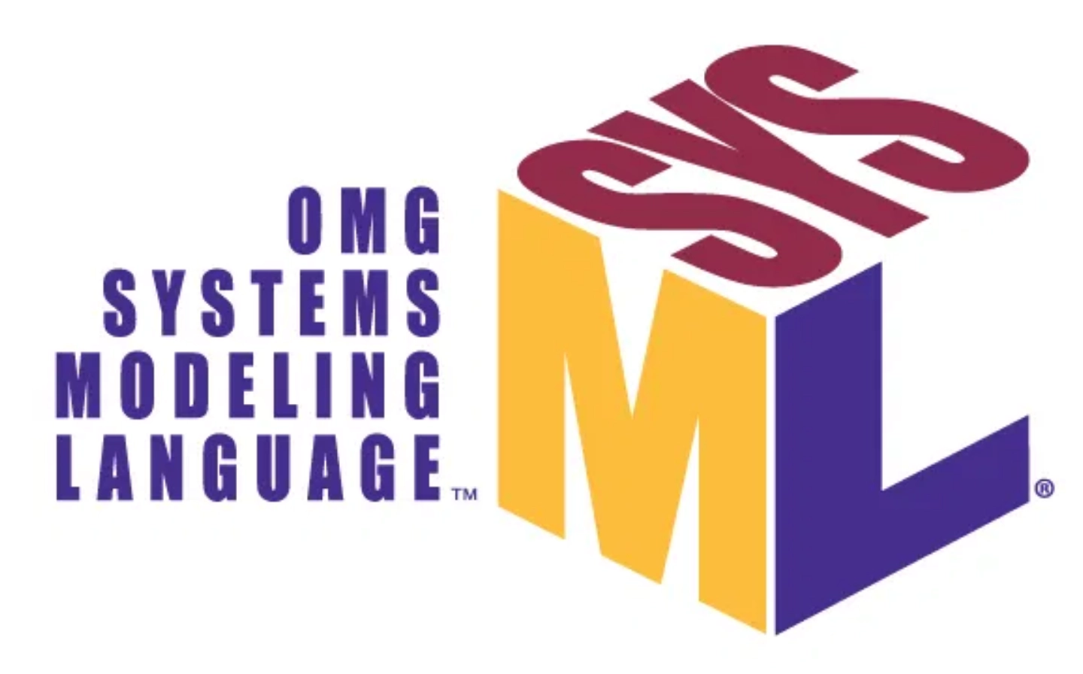
What is SysML?
Systems Modeling Language (SysML) is a general-purpose visual modeling language for systems engineering
Purpose:
Key Features:
Supports specification, analysis, design, verification, and validation of systems
Open source specification project
Extension to UML 2.0
Addresses hardware, software, information, processes, personnel, and facilities
Implemented as plugins for UML modeling tools
Enhances ability to manage growing system complexity
Overcomes UML's software bias for broader system modeling

Slide 9

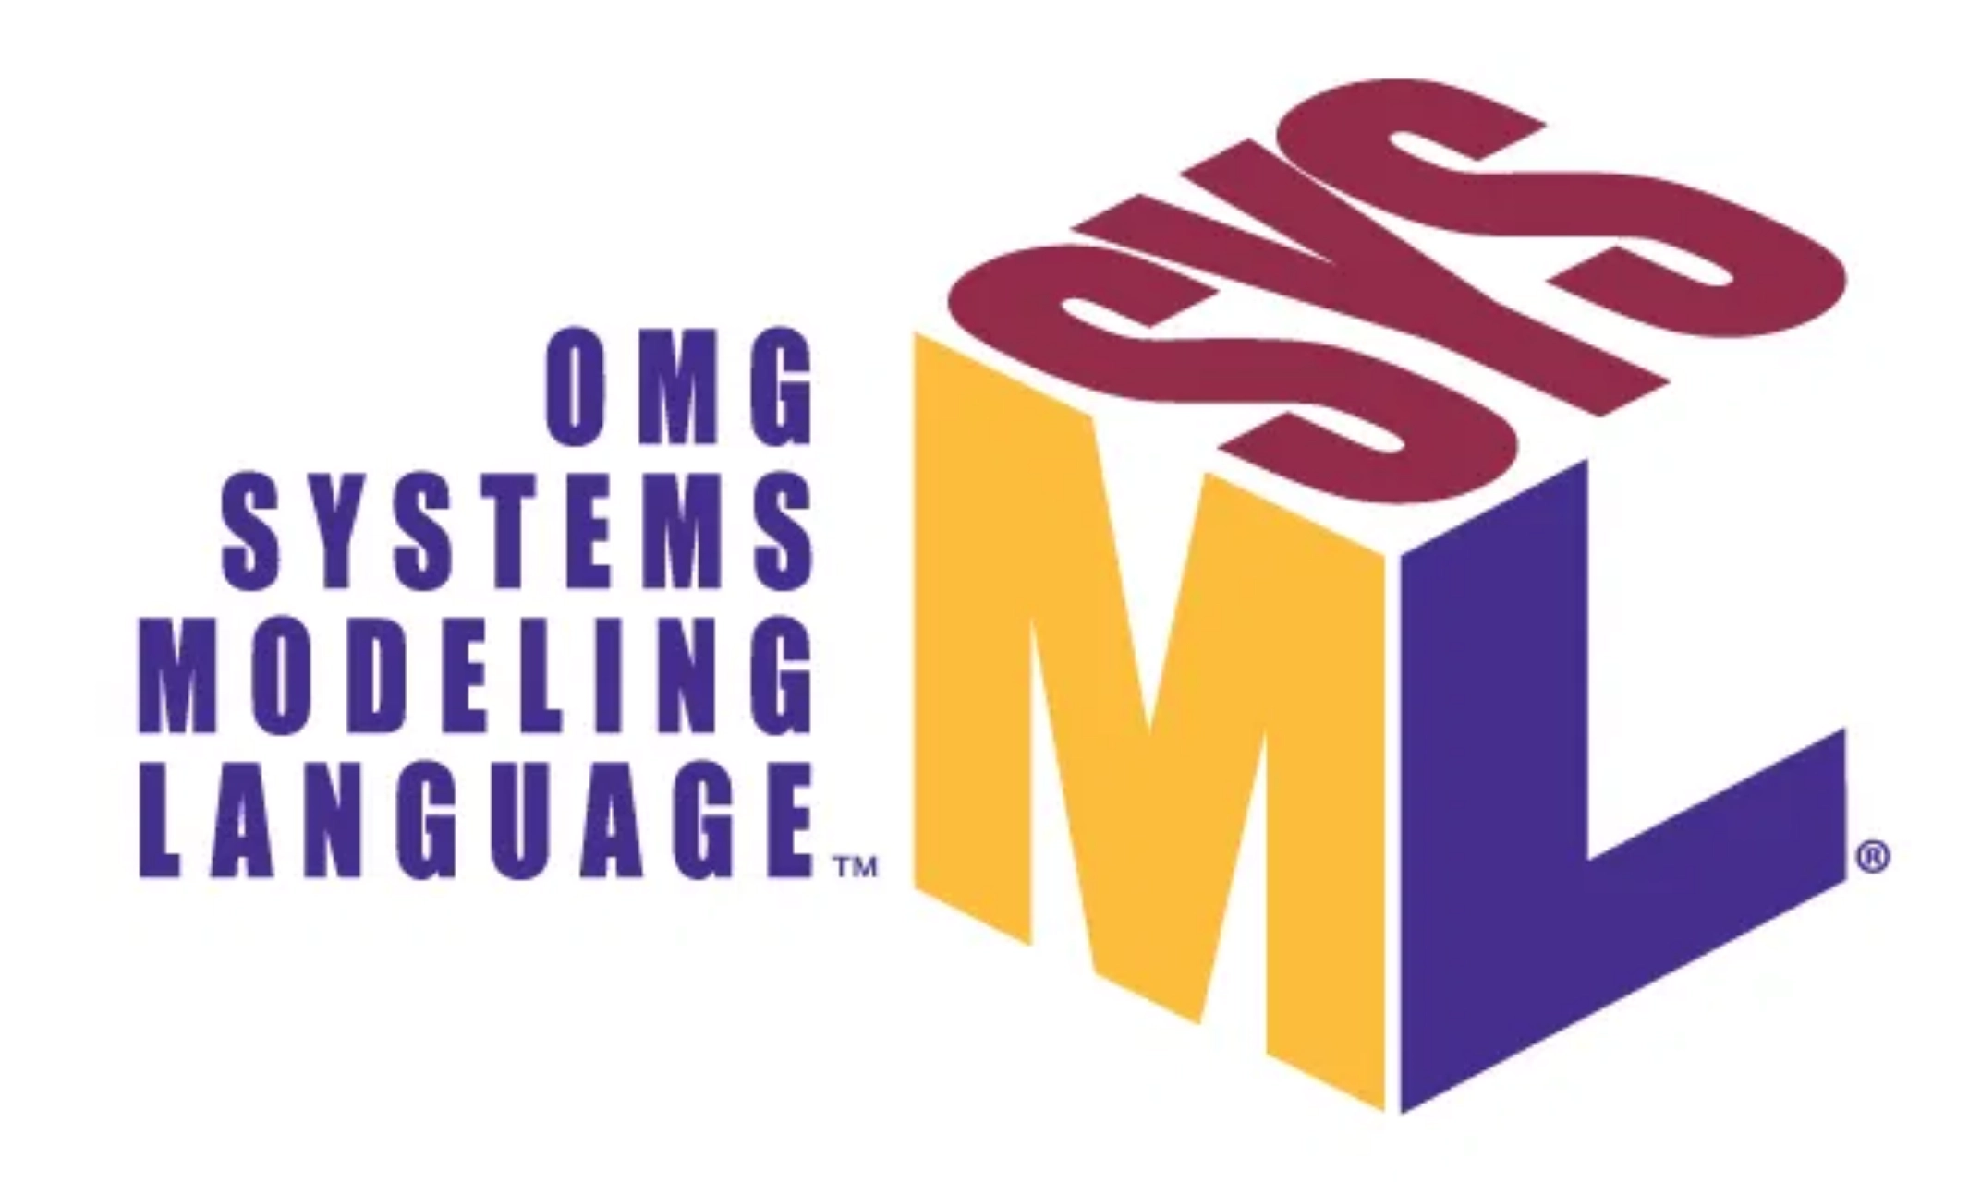
SysML Purpose and Development
Open Source Development
SysML was developed as an open source specification project with an open source license for distribution and use
Overcoming Software Bias
UML has a software bias that limits its application for broader systems engineering
Managing Complexity
SysML enhances the ability to manage growing system complexity across hardware, software, and other domains
SysML is specified as a profile (dialect) of UML 2.0
Frequently implemented as a plugin for popular UML modeling tools

Slide 10

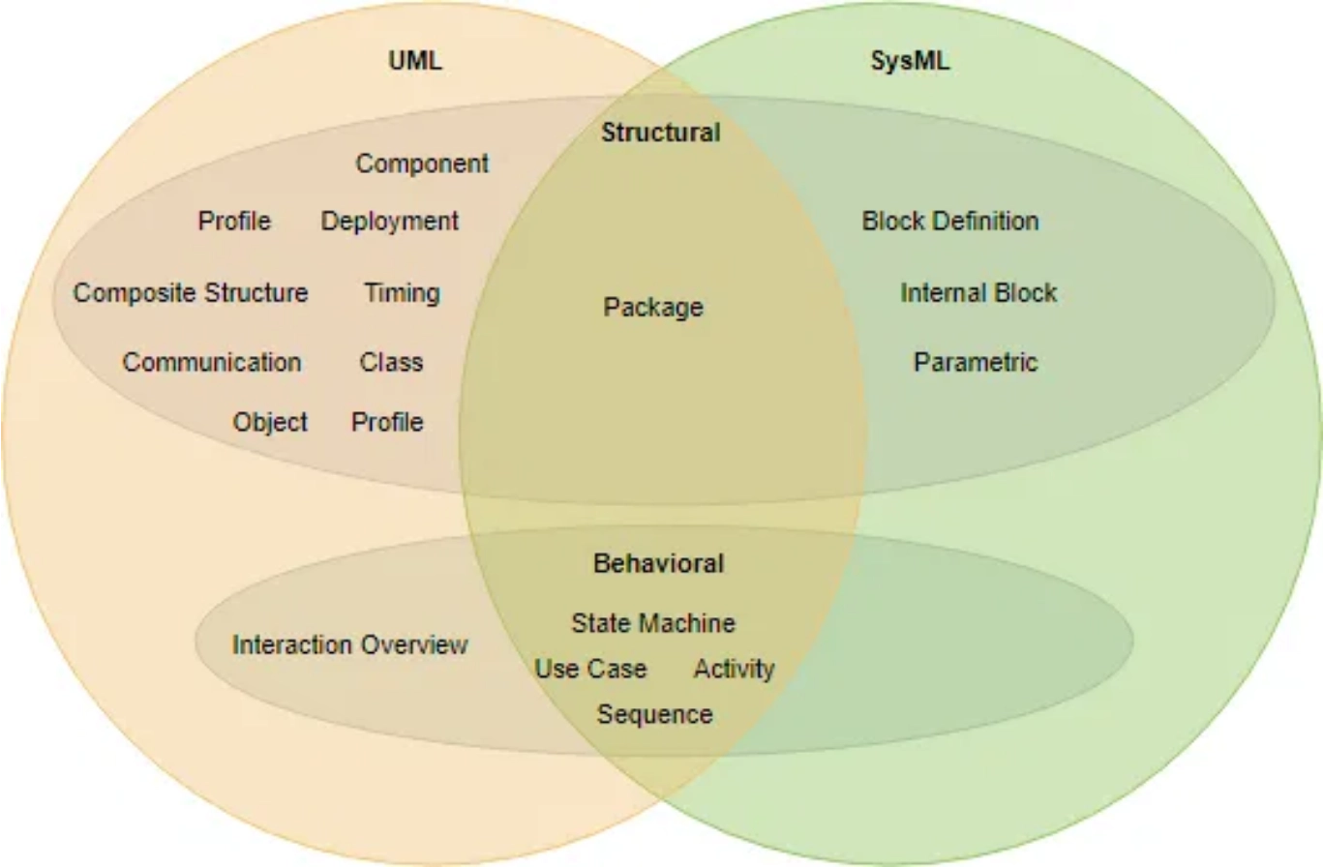
SysML vs UML

Slide 11
SysML vs UML
Aspect
UML
SysML
Focus
Software-centric modeling
Systems engineering (hardware, software, information, processes, personnel, facilities)
Relationship
Base language
Extension of UML (profile/dialect of UML 2.0)
Unique Features
Detailed software representation
Requirements diagram, parametric diagram, allocation tables
Implementation
Standalone modeling language
Frequently implemented as a plugin for popular UML modeling tools
Complexity
14 diagram types
9 diagram types (4 new/modified, 5 reused from UML)

Slide 12
SysML Diagram Types
Structure Diagrams
Behavior Diagrams
Cross-Cutting
Block Definition Diagram:
Parametric Diagram:
Activity Diagram:
Requirements Diagram:
Defines system hierarchy and classifications
Models constraints and equations between parts
Models flow of control between activities
Captures and traces system requirements
Internal Block Diagram:
Use Case Diagram:
Sequence Diagram:
Package Diagram:
Shows internal structure and connections
Shows system functionality from user perspective
Shows interactions between parts in time sequence
Shows organization and dependencies
State Machine Diagram:
Models system states and transitions

Slide 13
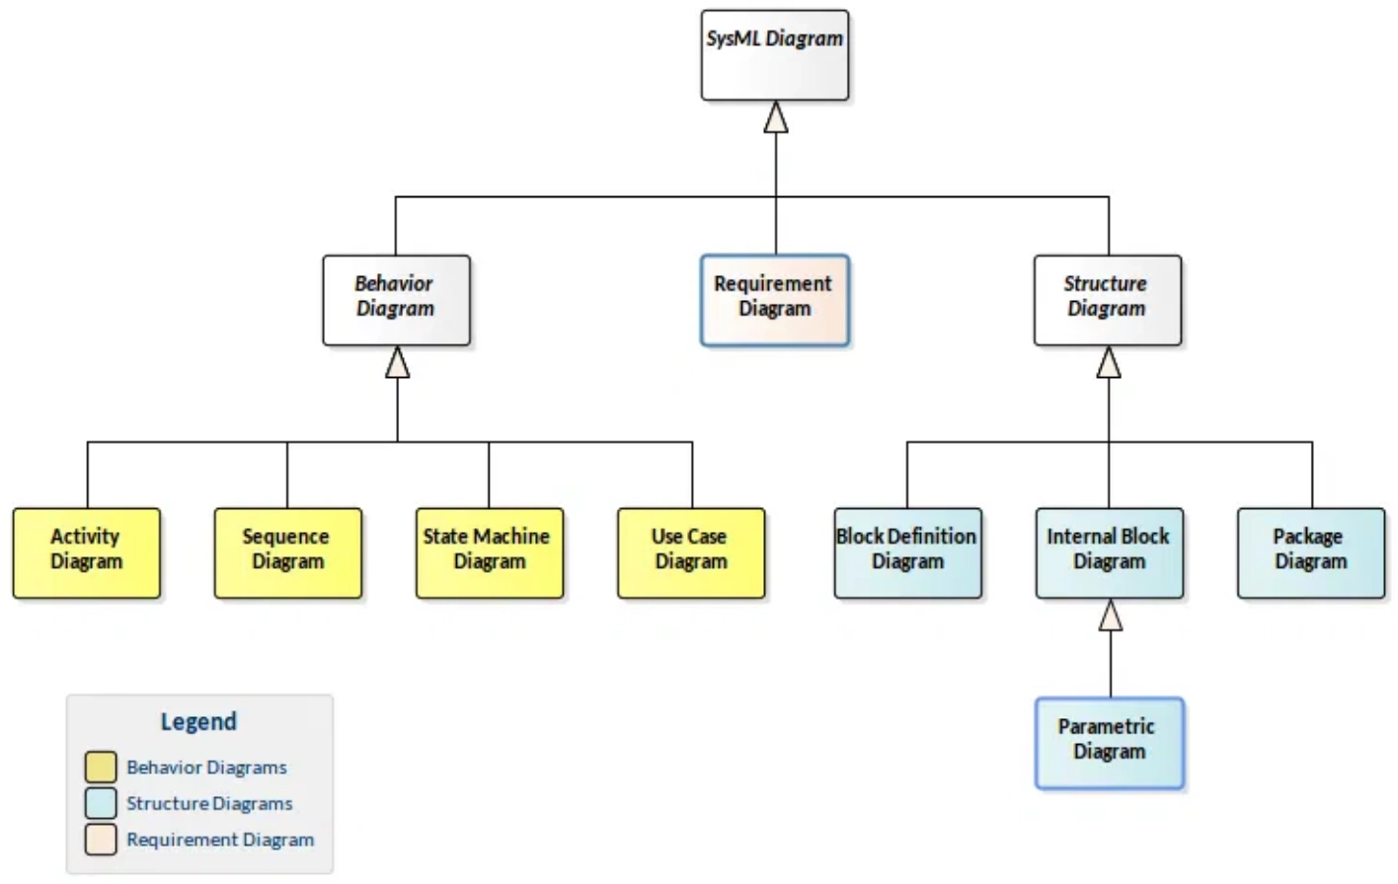



SysML Diagram Types
SysML Diagram Classification:
Same as UML: Use Case, Sequence, Activity Diagrams
Modified from UML: State Chart Diagram
Only in SysML: Requirements, Parametric Diagrams

Slide 14
Best Practices for UML Modeling
1. Keep Models Simple and Focused
Each diagram should have a clear purpose and audience. Avoid overcrowding diagrams with too much information. Use multiple diagrams if needed.
2. Use Consistent Naming Conventions
Maintain consistent naming for classes, methods, and other elements across all diagrams. This reduces confusion and improves readability.
3. Model at the Right Level of Detail
High-level diagrams for stakeholders, detailed diagrams for developers. Adjust abstraction level based on your audience.

Slide 15
Best Practices for UML Modeling
4. Keep Diagrams Up to Date
Models should evolve with the code. Outdated diagrams are worse than no diagrams as they can mislead developers.
5. Focus on Critical Areas
Not everything needs to be modeled. Focus on complex, critical, or frequently changing parts of the system.
6. Validate with Stakeholders
Regularly review diagrams with team members and stakeholders to ensure shared understanding and catch errors early.

Slide 16
When to Use Which UML Diagram
Requirements Phase:
Use Case Diagrams - Capture functional requirements and user interactions
Analysis Phase:
Class Diagrams (conceptual) - Identify domain concepts and relationships
Activity Diagrams - Model business processes and workflows
Design Phase:
Class Diagrams (detailed) - Define system structure with attributes and methods
Sequence Diagrams - Design object interactions for key scenarios
State Machine Diagrams - Model complex object lifecycles
Component Diagrams - Define software architecture and dependencies

Slide 17
When to Use Which UML Diagram
Implementation Phase:
Class Diagrams - Guide code structure
Package Diagrams - Organize code into logical modules
Deployment Phase:
Deployment Diagrams - Plan infrastructure and hardware configuration
Component Diagrams - Show physical distribution of software components
Throughout All Phases:
Object Diagrams - Illustrate specific scenarios and test cases
Communication Diagrams - Show structural relationships

Slide 18

Summary and Applications
Key Takeaways
Real-World Applications
Models simplify complex systems for better understanding
Software Development
Architecture design, code generation, documentation
UML is the standard for software modeling with focus on object-oriented design
Systems Engineering
SysML extends UML for broader systems engineering applications
Aerospace, automotive, defense, medical devices
Business Process Modeling
Both languages provide visual representations to improve communication
Workflow optimization, organizational structures
Requirements Engineering
Modeling reduces development time, cost, and risk
Capturing, analyzing, and tracking requirements
UML vs SysML:
Software-focused projects → UML
Complex systems with hardware/software → SysML

